Slide 1
PPT Functions
Slides in this presentation contain hyperlinks. JAWS users should be able to get a list of links by using INSERT+F7
Notes:
If this PowerPoint presentation contains mathematical equations, you may need to check that your computer has the following installed:
1) MathType Plugin
2) Math Player (free versions available)
3) NVDA Reader (free versions available)

Slide 2
5.1 Introduction
Most computer programs that solve real-world problems are much larger than the programs presented in the first few chapters.
Experience has shown that the best way to develop and maintain a large program is to construct it from smaller pieces, each of which is more manageable than the original program.
This technique is called divide and conquer.
This chapter describes some key features of the C language that facilitate the design, implementation, operation and maintenance of large programs.

Slide 3
5.2 Modularizing Programs in C (1 of 4)
Functions are used to modularize programs
C programs are typically written by combining new functions you write with prepackaged functions available in the C standard library.
The C standard library provides a rich collection of functions for performing common mathematical calculations, string manipulations, character manipulations, input/output, and many other useful operations.

Slide 4
5.2 Modularizing Programs in C (2 of 4)
The functions print f, scan f and pow that we’ve used in previous chapters are standard library functions.
You can write your own functions to define tasks that may be used at many points in a program.
These are sometimes referred to as programmer-defined functions.
The statements defining the function are written only once, and the statements are hidden from other functions.
Functions are invoked by a function call, which specifies the function name and provides information (as arguments) that the called function needs to perform its designated task.

Slide 5
5.2 Modularizing Programs in C (3 of 4)
A common analogy for this is the hierarchical form of management.
A boss (the calling function or caller) asks a worker (the called function) to perform a task and report back when the task is done (Figure 5.1).
For example, a function needing to display information on the screen calls the worker function print f to perform that task, then print f displays the information and reports back—or returns—to the calling function when its task is completed.
The boss function does not know how the worker function performs its designated tasks.

Slide 6
5.2 Modularizing Programs in C (4 of 4)
The worker may call other worker functions, and the boss will be unaware of this.
We’ll soon see how this “hiding” of implementation details promotes good software engineering.
Figure 5.1 shows a boss function communicating with several worker functions in a hierarchical manner.
Note that worker1 acts as a boss function to worker4 and worker5.
Relationships among functions may differ from the hierarchical structure shown in this figure.

Slide 7
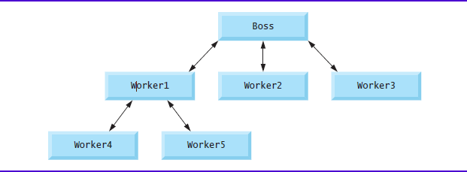
Figure 5.1 Hierarchical Boss-Function/Worker-Function Relationship

Slide 8

5.3 Math Library Functions (1 of 3)
Math library functions allow you to perform certain common mathematical calculations.
Functions are normally used in a program by writing the name of the function followed by a left parenthesis followed by the argument (or a comma-separated list of arguments) of the function followed by a right parenthesis.
For example, a programmer desiring to calculate and print the square root of 900.0 you might write
When this statement executes, the math library function s q r t is called to calculate the square root of the number contained in the parentheses (900.0).

Slide 9
5.3 Math Library Functions (2 of 3)
The number 900.0 is the argument of the s q r t function.
The preceding statement would print 30.00.
The s q r t function takes an argument of type double and returns a result of type double.
All functions in the math library that return floating-point values return the data type double.
Note that double values, like float values, can be output using the %f conversion specification.

Slide 10

Error-Prevention Tip 5.1
Include the math header by using the preprocessor directive
when using functions in the math library.

Slide 11
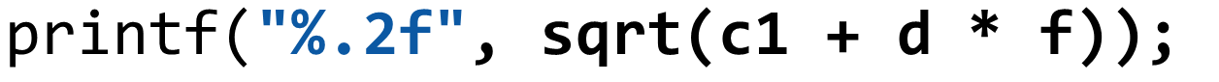

5.3 Math Library Functions (3 of 3)
Function arguments may be constants, variables, or expressions.
If c1 = 13.0, d = 3.0 and f = 4.0, then the statement
calculates and prints the square root of
namely 5.00.
In the figure, the variables x and y are of type double.

Slide 12

Figure 5.2 Commonly Used Math Library Functions (1 of 2)
Function | Description | Example
s q r t(x) | square root of x | s q r t(900.0) is 30.0 s q r t(9.0) is 3.0
c b r t(x) | cube root of x (C99 and C11 only) | c b r t(27.0) is 3.0 c b r t(−8.0) is −2.0
exp(x) | exponential function E to the power x. | exp(1.0) is 2.718282 exp(2.0) is 7.389056
log(x) | natural logarithm of x (base e) | log(2.718282) is 1.0 log(7.389056) is 2.0
log10(x) | logarithm of x (base 10) | log10(1.0) is 0.0 log10(10.0) is 1.0 log10(100.0) is 2.0
fabs(x) | absolute value of x as a floating-point number | fabs(13.5) is 13.5 fabs(0.0) is 0.0 fabs(−13.5) is 13.5
c e i l(x) | rounds x to the smallest integer not less than x | c e i l(9.2) is 10.0 c e i l(−9.8) is −9.0

Slide 13


Figure 5.2 Commonly Used Math Library Functions (2 of 2)
Function | Description | Example
floor(x) | rounds x to the largest integer not greater than x | floor(9.2) is 9.0 floor(−9.8) is −10.0
pow(x, y) | x raised to power y Left parenthesis x to the power y right parenthesis. | pow(2, 7) is 128.0 pow(9, .5) is 3.0
f mod(x, y) | remainder of Start fraction x over y end fraction. as a floating-point number | f mod(13.657, 2.333) is 1.992
sin(x) | trigonometric sine of x (x in radians) | sin(0.0) is 0.0
cos(x) | trigonometric cosine of x (x in radians) | cos(0.0) is 1.0
tan(x) | trigonometric tangent of x (x in radians) | tan(0.0) is 0.0

Slide 14
5.4 Functions (1 of 2)
Functions allow you to modularize a program.
All variables defined in function definitions are local variables—they can be accessed only in the function in which they’re defined.
Most functions have a list of parameters that provide the means for communicating information between functions.
A function’s parameters are also local variables of that function.

Slide 15

5.4 Functions (2 of 2)
There are several motivations for “functionalizing” a program.
The divide-and-conquer approach makes program development more manageable.
Another motivation is software reusability—using existing functions as building blocks to create new programs.
Software reusability is a major factor in the object-oriented programming movement that you’ll learn more about when you study languages derived from C, such as C++, Java and
We use abstraction each time we use standard library functions like print f, scan f and pow.
A third motivation is to avoid repeating code in a program.
Packaging code as a function allows the code to be executed from other locations in a program simply by calling the function.

Slide 16
5.5 Function Definitions (1 of 10)
Each program we’ve presented has consisted of a function called main that called standard library functions to accomplish its tasks.
We now consider how to write custom functions.
Consider a program that uses a function square to calculate and print the squares of the integers from 1 to 10 (Figure 5.3).

Slide 17
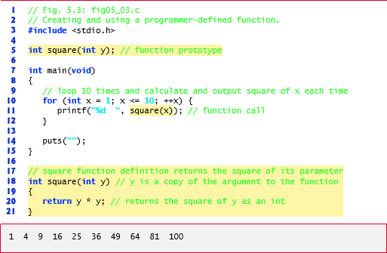
Figure 5.3 Creating and Using a Programmer-Defined Function

Slide 18

5.5 Function Definitions (2 of 10)
Function square is invoked or called in main within the print f statement
Function square receives a copy of the value of x in the parameter y.
Then square calculates
The result is passed back returned to function print f in main where square was invoked, and print f displays the result.
This process is repeated 10 times using the for statement.

Slide 19

5.5 Function Definitions (3 of 10)
The definition of function square shows that square expects an integer parameter y.
The keyword int preceding the function name indicates that square returns an integer result.
The return statement in square passes the value of the expression
(that is, the result of the calculation) back to the calling function.
  The int in parentheses informs the compiler that square expects to receive an integer value from the caller.

Slide 20
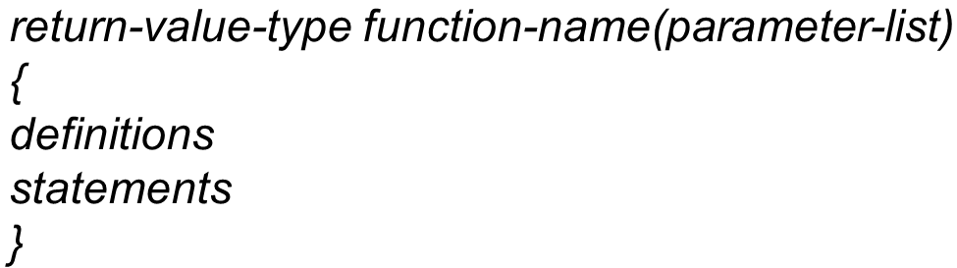
5.5 Function Definitions (4 of 10)
The int to the left of the function name square informs the compiler that square returns an integer result to the caller.
The compiler refers to the function prototype to check that any calls to square contain the correct return type, the correct number of arguments, the correct argument types, and that the arguments are in the correct order.
The format of a function definition is

Slide 21
5.5 Function Definitions (5 of 10)
The function-name is any valid identifier.
The return-value-type is the data type of the result returned to the caller.
The return-value-type void indicates that a function does not return a value.
Together, the return-value-type, function-name and parameter-list are sometimes referred to as the function header.

Slide 22
Error-Prevention Tip 5.2
Check that your functions that are supposed to return values do so. Check that your functions that are not supposed to return values do not.

Slide 23
5.5 Function Definitions (6 of 10)
The parameter-list is a comma-separated list that specifies the parameters received by the function when it’s called.
If a function does not receive any values, parameter-list is void.
A type must be listed explicitly for each parameter.

Slide 24
Common Programming Error 5.1
Specifying function parameters of the same type as double x, y instead of double x, double y results in a compilation error.

Slide 25
Common Programming Error 5.2
Placing a semicolon after the right parenthesis enclosing the parameter list of a function definition is a syntax error.

Slide 26
Common Programming Error 5.3
Redefining a parameter as a local variable in a function is a compilation error.

Slide 27
5.5 Function Definitions (7 of 10)
The definitions and statements within braces form the function body, which is also referred to as a block.
Variables can be declared in any block, and blocks can be nested.

Slide 28
Common Programming Error 5.4
Defining a function inside another function is a syntax error.

Slide 29
5.5 Function Definitions (8 of 10)
There are three ways to return control from a called function to the point at which a function was invoked.
If the function does not return a result, control is returned simply when the function-ending right brace is reached, or by executing the statement
return;
If the function does return a result, the statement
return expression;
returns the value of expression to the caller.

Slide 30
5.5 Function Definitions (9 of 10)
main’s Return Type
Notice that main has an int return type.
The return value of main is used to indicate whether the program executed correctly.
In earlier versions of C, we’d explicitly place
return 0;
at the end of main—0 indicates that a program ran successfully.
The C standard indicates that main implicitly returns 0 if you to omit the preceding statement—as we’ve done throughout this book.

Slide 31
5.5 Function Definitions (10 of 10)
You can explicitly return non-zero values from main to indicate that a problem occurred during your program’s execution.
For information on how to report a program failure, see the documentation for your particular operating-system environment.

Slide 32
5.5 Function Definitions (11 of 10)
Function maximum
Our second example uses a programmer-defined function maximum to determine and return the largest of three integers (Figure 5.4).
Next, they’re passed to maximum, which determines the largest integer.
This value is returned to main by the return statement in maximum.

Slide 33
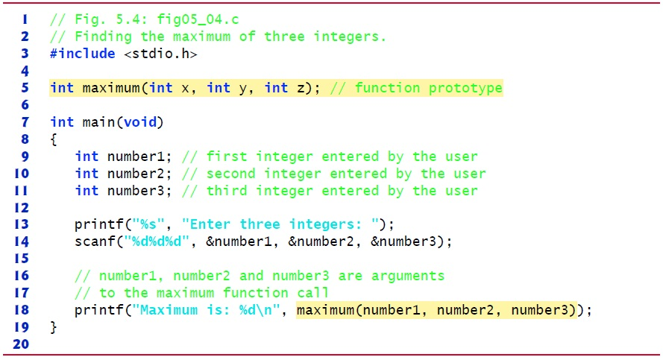
Figure 5.4 Finding the Maximum of Three Integers (1 of 3)

Slide 34
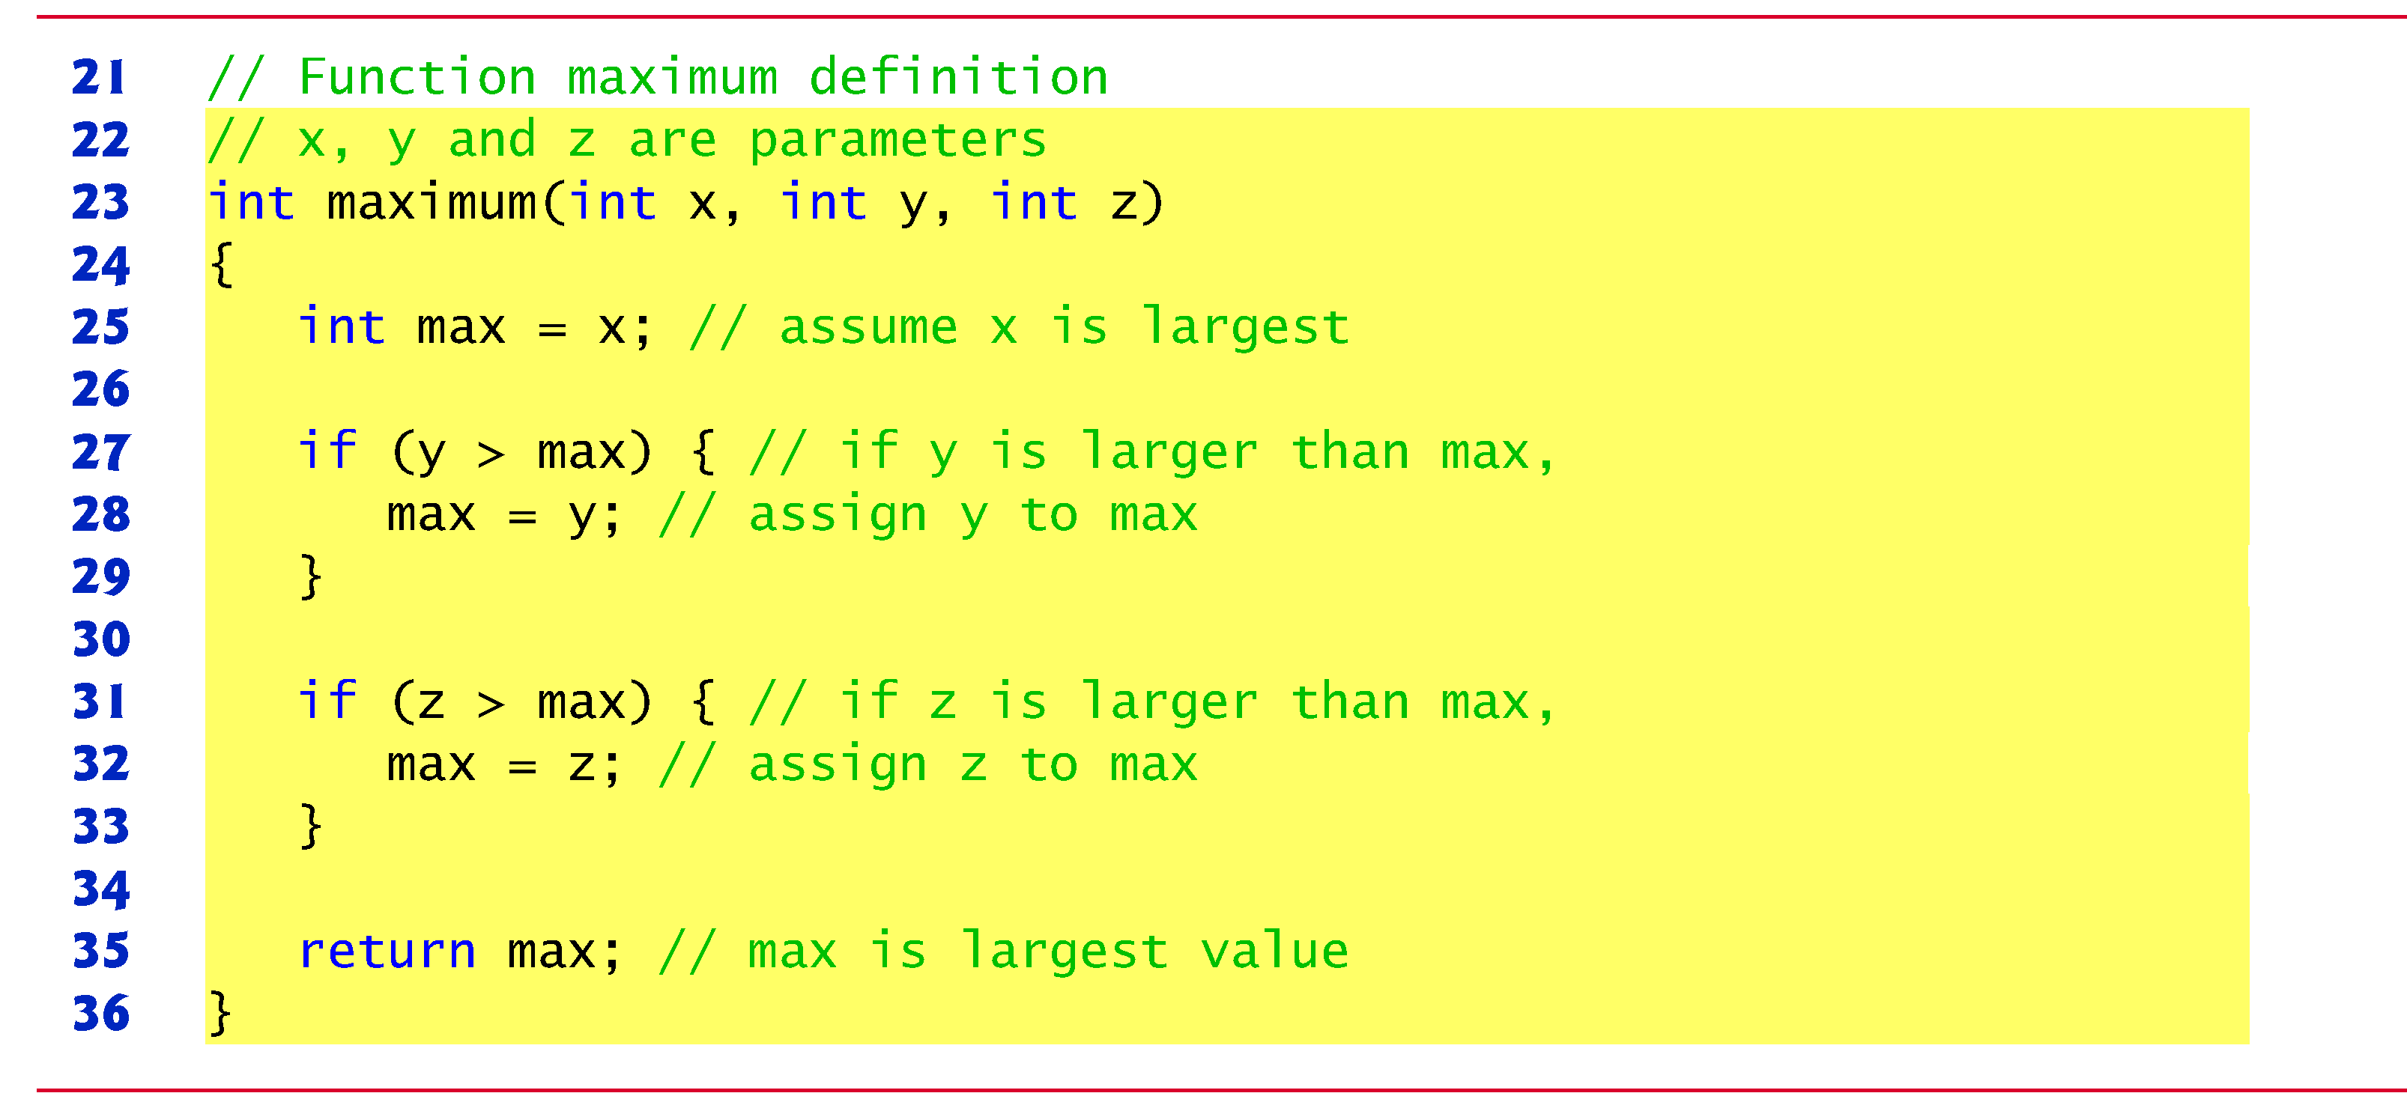
Figure 5.4 Finding the Maximum of Three Integers (2 of 3)

Slide 35
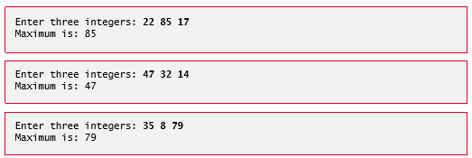
Figure 5.4 Finding the Maximum of Three Integers (3 of 3)

Slide 36
5.6 Function Prototypes: A Deeper Look (1 of 12)
An important feature of C is the function prototype.
This feature was borrowed from C++.
The compiler uses function prototypes to validate function calls.

Slide 37
5.6 Function Prototypes: A Deeper Look (2 of 12)
Early versions of C did not perform this kind of checking, so it was possible to call functions improperly without the compiler detecting the errors.
Such calls could result in fatal execution-time errors or nonfatal errors that caused subtle, difficult-to-detect problems.

Slide 38
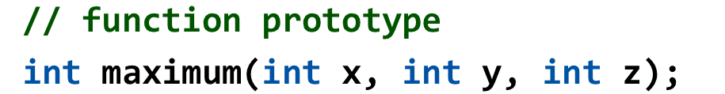
5.6 Function Prototypes: A Deeper Look (3 of 12)
The function prototype for maximum in Figure 5.4 is
It states that maximum takes three arguments of type int and returns a result of type int.
Notice that the function prototype is the same as the first line of maximum’s function definition.

Slide 39
Common Programming Error 5.5
Forgetting the semicolon at the end of a function prototype is a syntax error.

Slide 40

5.6 Function Prototypes: A Deeper Look (4 of 12)
Compilation Errors
A function call that does not match the function prototype is a compilation error.
An error is also generated if the function prototype and the function definition disagree.
For example, in Figure 5.4), if the function prototype had been written
the compiler would generate an error because the void return type in the function prototype would differ from the int return type in the function header.

Slide 41


5.6 Function Prototypes: A Deeper Look (5 of 12)
Argument Coercion and “Usual Arithmetic Conversion Rules”
Another important feature of function prototypes is the coercion of arguments, i.e., the forcing of arguments to the appropriate type.
For example, the math library function sqrt can be called with an integer argument even though the function prototype in
specifies a double parameter, and the function will still work correctly.
The statement
correctly evaluates s q r t(4) and prints the value 2.000.

Slide 42
5.6 Function Prototypes: A Deeper Look (6 of 12)
The function prototype causes the compiler to convert a copy of the integer value 4 to the double value 4.0 before the copy is passed to s q r t.
In general, argument values that do not correspond precisely to the parameter types in the function prototype are converted to the proper type before the function is called.
These conversions can lead to incorrect results if C’s usual arithmetic conversion rules are not followed.
These rules specify how values can be converted to other types without losing data.

Slide 43
5.6 Function Prototypes: A Deeper Look (7 of 12)
In our s q r t example above, an int is automatically converted to a double without changing its value.
However, a double converted to an int truncates the fractional part of the double value, thus changing the original value.
Converting large integer types to small integer types (e.g., long to short) may also result in changed values.

Slide 44
5.6 Function Prototypes: A Deeper Look (8 of 12)
The usual arithmetic conversion rules automatically apply to expressions containing values of two or more data types (also referred to as mixed-type expressions) and are handled for you by the compiler.
In a mixed-type expression, the compiler makes a temporary copy of the value that needs to be converted then converts the copy to the “highest” type in the expression—the original value remains unchanged.

Slide 45
5.6 Function Prototypes: A Deeper Look (9 of 12)
The usual arithmetic conversion rules for a mixed-type expression containing at least one floating-point value are:
  If one of the values is a long double, the other is converted to a long double.
  If one of the values is a double, the other is converted to a double.
  If one of the values is a float, the other is converted to a float.

Slide 46
5.6 Function Prototypes: A Deeper Look (10 of 12)
If the mixed-type expression contains only integer types, then the usual arithmetic conversions specify a set of integer promotion rules.
In most cases, the integer types lower in Figure 5.5 are converted to types higher in the figure.
Section 6.3.1 of the C standard document specifies the complete details of arithmetic operands and the usual arithmetic conversion rules.
Figure 5.5 lists the floating-point and data types with each type’s print f and scan f conversion specifications.

Slide 47
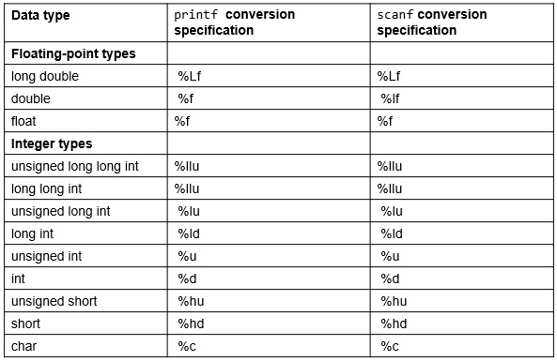
Figure 5.5 Arithmetic Data Types and Their Conversion Specifications

Slide 48
5.6 Function Prototypes: A Deeper Look (11 of 12)
A value can be converted to a lower type only by explicitly assigning the value to a variable of lower type, or by using a cast operator.
Function argument values are converted to the parameter types in a function prototype as if they were being assigned directly to variables of those types.
If our square function that uses an integer parameter (Figure 5.3) is called with a floating-point argument, the argument is converted to int (a lower type), and square usually returns an incorrect value.
For example, square(4.5) returns 16, not 20.25.

Slide 49
Common Programming Error 5.6
Converting from a higher data type in the promotion hierarchy to a lower type can change the data value. Many compilers issue warnings in such cases.

Slide 50
5.6 Function Prototypes: A Deeper Look (12 of 12)
If there is no function prototype for a function, the compiler forms its own function prototype using the first occurrence of the function—either the function definition or a call to the function.
This typically leads to warnings or errors, depending on the compiler.

Slide 51
Error-Prevention Tip 5.3
Always include function prototypes for the functions you define or use in your program to help prevent compilation errors and warnings.

Slide 52
5.7 Function Call Stack and Stack Frames (1 of 12)
To understand how C performs function calls, we first need to consider a data structure (i.e., collection of related data items) known as a stack.
Think of a stack as analogous to a pile of dishes.
When a dish is placed on the pile, it’s normally placed at the top (referred to as pushing the dish onto the stack).
Similarly, when a dish is removed from the pile, it’s normally removed from the top (referred to as popping the dish off the stack).
Stacks are known as last-in, first-out (L I F O) data structures—the last item pushed (inserted) on the stack is the first item popped (removed) from the stack.

Slide 53
5.7 Function Call Stack and Stack Frames (2 of 12)
An important mechanism for computer science students to understand is the function call stack (sometimes referred to as the program execution stack).
This data structure—working “behind the scenes”—supports the function call/return mechanism.
It also supports the creation, maintenance and destruction of each called function’s local variables.

Slide 54
5.7 Function Call Stack and Stack Frames (3 of 12)
As each function is called, it may call other functions, which may call other functions—all before any function returns.
Each function eventually must return control to the function that called it.
So, we must keep track of the return addresses that each function needs to return control to the function that called it.
The function call stack is the perfect data structure for handling this information.

Slide 55
5.7 Function Call Stack and Stack Frames (4 of 12)
Each time a function calls another function, an entry is pushed onto the stack.
This entry, called a stack frame, contains the return address that the called function needs in order to return to the calling function.
If the called function returns, instead of calling another function before returning, the stack frame for the function call is popped, and control transfers to the return address in the popped stack frame.

Slide 56
5.7 Function Call Stack and Stack Frames (5 of 12)
Each called function always finds the information it needs to return to its caller at the top of the call stack.
And, if a function makes a call to another function, a stack frame for the new function call is simply pushed onto the call stack.
Thus, the return address required by the newly called function to return to its caller is now located at the top of the stack.

Slide 57
5.7 Function Call Stack and Stack Frames (6 of 12)
The stack frames have another important responsibility.
Most functions have automatic variables—parameters and some or all of their local variables.
Automatic variables need to exist while a function is executing.
They need to remain active if the function makes calls to other functions.
But when a called function returns to its caller, the called function’s automatic variables need to “go away.”

Slide 58
5.7 Function Call Stack and Stack Frames (7 of 12)
The called function’s stack frame is a perfect place to reserve the memory for automatic variables.
That stack frame exists only as long as the called function is active.
When that function returns—and no longer needs its local automatic variables—its stack frame is popped from the stack, and those local automatic variables are no longer known to the program.

Slide 59
5.7 Function Call Stack and Stack Frames (8 of 12)
Of course, the amount of memory in a computer is finite, so only a certain amount of memory can be used to store stack frames on the function call stack.
If more function calls occur than can have their stack frames stored on the function call stack, a fatal error known as a stack overflow occurs.

Slide 60
5.7 Function Call Stack and Stack Frames (9 of 12)
Function Call Stack in Action
Now let’s consider how the call stack supports the operation of a square function called by main
First the operating system calls main—this pushes a stack frame onto the stack.
The stack frame tells main how to return to the operating system (i.e., transfer to return address R1) and contains the space for main’s automatic variable (i.e., a, which is initialized to 10).

Slide 61
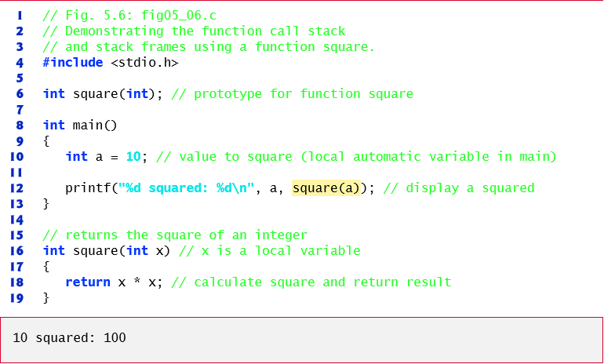
Figure 5.6 Demonstrating the Function Call Stack and Stack Frames Using a Function Square

Slide 62
5.7 Function Call Stack and Stack Frames (10 of 12)
Function main—before returning to the operating system—now calls function square
This causes a stack frame for square to be pushed onto the function call stack (Figure 5.8).
This stack frame contains the return address that square needs to return to main (i.e., R2) and the memory for square’s automatic variable (i.e., x).

Slide 63
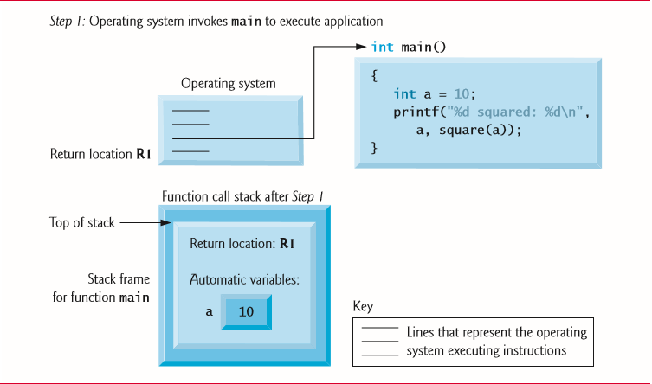
Figure 5.7 Function Call Stack After the Operating System Invokes Main to Execute the Program

Slide 64
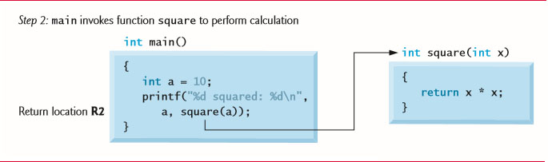
Figure 5.8 Function Call Stack After Main Invokes Square to Perform the Calculation (1 of 2)

Slide 65
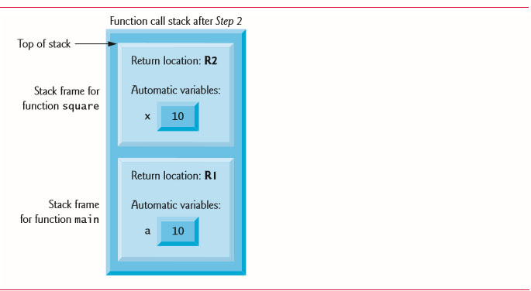
Figure 5.8 Function Call Stack After Main Invokes Square to Perform the Calculation (2 of 2)

Slide 66
5.7 Function Call Stack and Stack Frames (11 of 12)
After square calculates the square of its argument, it needs to return to main—and no longer needs the memory for its automatic variable x.
So the stack is popped—giving square the return location in main (i.e., R2) and losing square’s automatic variable.
Figure 5.9 shows the function call stack after square’s stack frame has been popped.

Slide 67
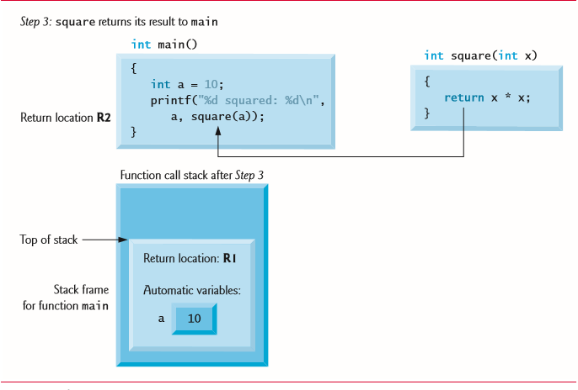
Figure 5.9 Function Call Stack After Function Square Returns to Main

Slide 68
5.7 Function Call Stack and Stack Frames (12 of 12)
Function main now displays the result of calling square
Reaching the closing right brace of main causes its stack frame to be popped from the stack, gives main the address it needs to return to the operating system (i.e., R1 in Figure 5.7) and causes the memory for main’s automatic variable (i.e., a) to become unavailable.

Slide 69
5.8 Headers (1 of 2)
Each standard library has a corresponding header containing the function prototypes for all the functions in that library and definitions of various data types and constants needed by those functions.
Figure 5.6) lists alphabetically some of the standard library headers that may be included in programs.
The term “macros” that’s used several times in Figure 5.6) is discussed in detail in Chapter 13.
You can create custom headers.
Programmer-defined headers should also use the .h filename extension.

Slide 70

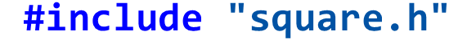
5.8 Headers (2 of 2)
A programmer-defined header can be included by using the
preprocessor directive.
For example, if the prototype for our square function was located in the header square.h, we’d include that header in our program by using the following directive at the top of the program:

Slide 71







Figure 5.10 Some of the Standard Library Headers (1 of 2)
Header | Explanation
Left angle bracket assert period h right angle bracket. | Contains information for adding diagnostics that aid program debugging.
Left angle bracket c type period h right angle bracket. | Contains function prototypes for functions that test characters for certain properties, and function prototypes for functions that can be used to convert lowercase letters to uppercase letters and vice versa.
Left angle bracket e r r n o period h right angle bracket. | Defines macros that are useful for reporting error conditions.
Left angle bracket float period h right angle bracket. | Contains the floating-point size limits of the system.
Left angle bracket limits period h right angle bracket. | Contains the integral size limits of the system.
Left angle bracket locale period h right angle bracket. | Contains function prototypes and other information that enables a program to be modified for the current locale on which it’s running. The notion of locale enables the computer system to handle different conventions for expressing data such as dates, times, currency amounts and large numbers throughout the world.
Left angle bracket math period h right angle bracket. | Contains function prototypes for math library functions.

Slide 72








Figure 5.10 Some of the Standard Library Headers (2 of 2)
Header | Explanation
Left angle bracket set j m p period h right angle bracket. | Contains function prototypes for functions that allow bypassing of the usual function call and return sequence.
Left angle bracket signal period h right angle bracket. | Contains function prototypes and macros to handle various conditions that may arise during program execution.
Left angle bracket s t d a r g period h right angle bracket. | Defines macros for dealing with a list of arguments to a function whose number and types are unknown.
Left angle bracket s t d e f period h right angle bracket. | Contains common type definitions used by C for performing calculations.
Left angle bracket s t d I o period h right angle bracket. | Contains function prototypes for the standard input/output library functions, and information used by them.
Left angle bracket s t d l I b period h right angle bracket. | Contains function prototypes for conversions of numbers to text and text to numbers, memory allocation, random numbers and other utility functions.
Left angle bracket string period h right angle bracket | Contains function prototypes for string-processing functions.
Left angle bracket time period h right angle bracket. | Contains function prototypes and types for manipulating the time and date.

Slide 73
5.9 Passing Arguments by Value and by Reference (1 of 2)
In many programming languages, there are two ways to pass arguments—pass-by-value and pass-by-reference.
When arguments are passed by value, a copy of the argument’s value is made and passed to the called function.
Changes to the copy do not affect an original variable’s value in the caller.
When an argument is passed by reference, the caller allows the called function to modify the original variable’s value.
Pass-by-value should be used whenever the called function does not need to modify the value of the caller’s original variable.

Slide 74
5.9 Passing Arguments by Value and by Reference (2 of 2)
This prevents the accidental side effects (variable modifications) that so greatly hinder the development of correct and reliable software systems.
Pass-by-reference should be used only with trusted called functions that need to modify the original variable.
In C, all arguments are passed by value.
array arguments are automatically passed by reference for performance reasons.

Slide 75
5.12 Storage Classes (1 of 10)
we used identifiers for variable names.
The attributes of variables include name, type, size and value.
we also use identifiers as names for user-defined functions.
Actually, each identifier in a program has other attributes, including storage class, storage duration, scope and linkage.
C provides the storage class specifiers: auto, register, extern and static.
An identifier’s storage class determines its storage duration, scope and linkage.
An identifier’s storage duration is the period during which the identifier exists in memory.

Slide 76
5.12 Storage Classes (2 of 10)
Some exist briefly, some are repeatedly created and destroyed, and others exist for the program’s entire execution.
An identifier’s scope is where the identifier can be referenced in a program.
Some can be referenced throughout a program, others from only portions of a program.
An identifier’s linkage determines for a multiple-source-file program whether the identifier is known only in the current source file or in any source file with proper declarations.
This section discusses storage classes and storage duration.

Slide 77
5.12 Storage Classes (3 of 10)
Section 5.13 discusses scope.
Chapter 14 discusses identifier linkage and programming with multiple source files.
The storage-class specifiers can be split into automatic storage duration and static storage duration.
Keyword auto is used to declare variables of automatic storage duration.
Variables with automatic storage duration are created when the block in which they’re defined is entered; they exist while the block is active, and they’re destroyed when the block is exited.

Slide 78
5.12 Storage Classes (4 of 10)
Local Variables
Only variables can have automatic storage duration.
A function’s local variables (those declared in the parameter list or function body) normally have automatic storage duration.
Keyword auto explicitly declares variables of automatic storage duration.

Slide 79
5.12 Storage Classes (5 of 10)
Local variables have automatic storage duration by default, so keyword auto is rarely used.
For the remainder of the text, we’ll refer to variables with automatic storage duration simply as automatic variables.

Slide 80
5.12 Storage Classes (6 of 10)
Static Storage Class
Keywords extern and static are used in the declarations of identifiers for variables and functions of static storage duration.
Identifiers of static storage duration exist from the time at which the program begins execution until the program terminates.
For static variables, storage is allocated and initialized only once, before the program begins execution.
For functions, the name of the function exists when the program begins execution.

Slide 81
5.12 Storage Classes (7 of 10)
However, even though the variables and the function names exist from the start of program execution, this does not mean that these identifiers can be accessed throughout the program.
Storage duration and scope (where a name can be used) are separate issues, as we’ll see in Section 5.13.
There are several types of identifiers with static storage duration: external identifiers (such as global variables and function names) and local variables declared with the storage-class specifier static.
Global variables and function names are of storage class extern by default.

Slide 82
5.12 Storage Classes (8 of 10)
Global variables are created by placing variable declarations outside any function definition, and they retain their values throughout the execution of the program.
Global variables and functions can be referenced by any function that follows their declarations or definitions in the file.
This is one reason for using function prototypes—when we include s t d i o.h in a program that calls print f, the function prototype is placed at the start of our file to make the name print f known to the rest of the file.

Slide 83

5.12 Storage Classes (9 of 10)
Local variables declared with the keyword static are still known only in the function in which they’re defined, but unlike automatic variables, static local variables retain their value when the function is exited.
The next time the function is called, the static local variable contains the value it had when the function last exited.
The following statement declares local variable count to be static and initializes it to 1.

Slide 84
5.12 Storage Classes (10 of 10)
All numeric variables of static storage duration are initialized to zero by default if you do not explicitly initialize them.
Keywords extern and static have special meaning when explicitly applied to external identifiers.
In Chapter 14 we discuss the explicit use of extern and static with external identifiers and multiple-source-file programs.

Slide 85
5.13 Scope Rules (1 of 9)
The scope of an identifier is the portion of the program in which the identifier can be referenced.
For example, when we define a local variable in a block, it can be referenced only following its definition in that block or in blocks nested within that block.
The four identifier scopes are function scope, file scope, block scope, and function-prototype scope.
Labels (identifiers followed by a colon such as start:) are the only identifiers with function scope.
Labels can be used anywhere in the function in which they appear, but cannot be referenced outside the function body.

Slide 86
5.13 Scope Rules (2 of 9)
Labels are used in switch statements (as case labels) and in goto statements (see Chapter 14).
Labels are hidden in the function in which they’re defined.
This hiding—more formally called information hiding—is a means of implementing the principle of least privilege—a fundamental principle of good software engineering.
An identifier declared outside any function has file scope.
Such an identifier is “known” (i.e., accessible) in all functions from the point at which the identifier is declared until the end of the file.

Slide 87
5.13 Scope Rules (3 of 9)
Global variables, function definitions, and function prototypes placed outside a function all have file scope.
Identifiers defined inside a block have block scope.
Block scope ends at the terminating right brace (}) of the block.
Local variables defined at the beginning of a function have block scope as do function parameters, which are considered local variables by the function.
Any block may contain variable definitions.

Slide 88
5.13 Scope Rules (4 of 9)
When blocks are nested, and an identifier in an outer block has the same name as an identifier in an inner block, the identifier in the outer block is “hidden” until the inner block terminates.
This means that while executing in the inner block, the inner block sees the value of its own local identifier and not the value of the identically named identifier in the enclosing block.
Local variables declared static still have block scope, even though they exist from before program startup.

Slide 89
5.13 Scope Rules (5 of 9)
Thus, storage duration does not affect the scope of an identifier.
The only identifiers with function-prototype scope are those used in the parameter list of a function prototype.
As mentioned previously, function prototypes do not require names in the parameter list—only types are required.
If a name is used in the parameter list of a function prototype, the compiler ignores the name.
Identifiers used in a function prototype can be reused elsewhere in the program without ambiguity.

Slide 90
Common Programming Error 5.8
Accidentally using the same name for an identifier in an inner block as is used for an identifier in an outer block, when in fact you want the identifier in the outer block to be active for the duration of the inner block.

Slide 91
Error-Prevention Tip 5.4
Avoid variable names that hide names in outer scopes.

Slide 92
5.13 Scope Rules (6 of 9)
Figure 5.16 demonstrates scoping issues with global variables, automatic local variables, and static local variables.
A global variable x is defined and initialized to 1.
This global variable is hidden in any block (or function) in which a variable named x is defined.
In main, a local variable x is defined and initialized to 5
This variable is then printed to show that the global x is hidden in main.
Next, a new block is defined in main with another local variable x initialized to 7

Slide 93
5.13 Scope Rules (7 of 9)
This variable is printed to show that it hides x in the outer block of main.
The variable x with value 7 is automatically destroyed when the block is exited, and the local variable x in the outer block of main is printed again to show that it’s no longer hidden.
The program defines three functions that each take no arguments and return nothing.
Function use Local defines an automatic variable x and initializes it to 25
When use Local is called, the variable is printed, incremented, and printed again before exiting the function.

Slide 94
5.13 Scope Rules (8 of 9)
Each time this function is called, automatic variable x is reinitialized to 25.
Function use Static Local defines a static variable x and initializes it to 50
Local variables declared as static retain their values even when they’re out of scope.
When use Static Local is called, x is printed, incremented, and printed again before exiting the function.
In the next call to this function, static local variable x will contain the value 51.
Function use Global does not define any variables.

Slide 95
5.13 Scope Rules (9 of 9)
Therefore, when it refers to variable x, the global x is used.
When use Global is called, the global variable is printed, multiplied by 10, and printed again before exiting the function.
The next time function use Global is called, the global variable still has its modified value, 10.
Finally, the program prints the local variable x in main again to show that none of the function calls modified the value of x because the functions all referred to variables in other scopes.

Slide 96
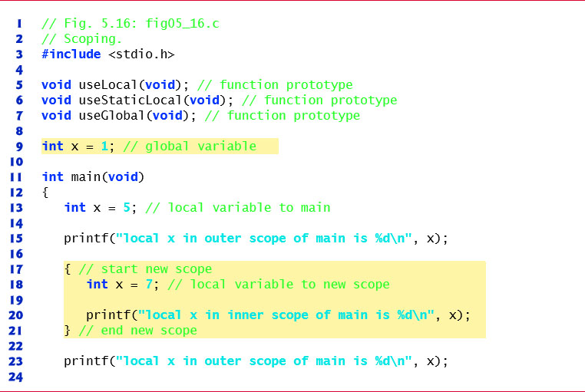
Figure 5.16 Scoping (1 of 4)

Slide 97
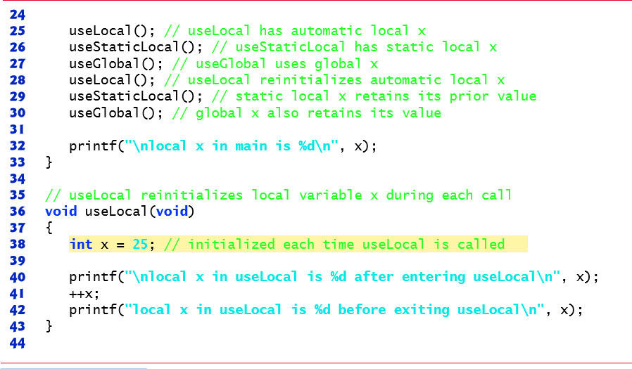
Figure 5.16 Scoping (2 of 4)

Slide 98
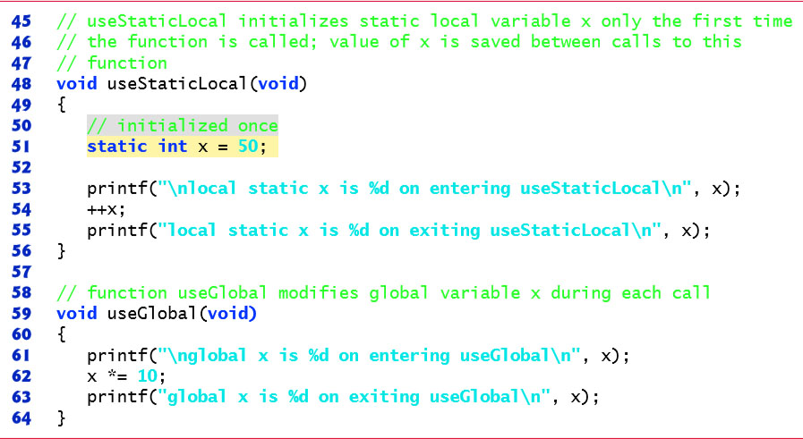
Figure 5.16 Scoping (3 of 4)

Slide 99
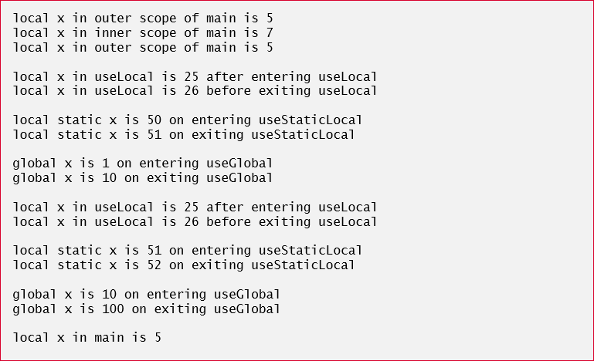
Figure 5.16 Scoping (4 of 4)

Slide 100
5.14 Recursion (1 of 12)
The programs we’ve discussed are generally structured as functions that call one another in a disciplined, hierarchical manner.
For some types of problems, it’s useful to have functions call themselves.
A recursive function is a function that calls itself either directly or indirectly through another function.
Recursion is a complex topic discussed at length in upper-level computer science courses.
In this section and the next, simple examples of recursion are presented.

Slide 101
5.14 Recursion (2 of 12)
This book contains an extensive treatment of recursion, which is spread throughout Chapters 5–8, 12 and Appendix F.
Figure 5.17, in Section 5.16, summarizes the 31 recursion examples and exercises in the book.
We consider recursion conceptually first, then examine several programs containing recursive functions.
Recursive problem-solving approaches have a number of elements in common.
A recursive function is called to solve a problem.
The function actually knows how to solve only the simplest case(s), or so-called base case(s).

Slide 102
5.14 Recursion (3 of 12)
If the function is called with a base case, the function simply returns a result.
If the function is called with a more complex problem, the function divides the problem into two conceptual pieces: a piece that the function knows how to do and a piece that it does not know how to do.
To make recursion feasible, the latter piece must resemble the original problem, but be a slightly simpler or smaller version.

Slide 103
5.14 Recursion (4 of 12)
Because this new problem looks like the original problem, the function launches (calls) a fresh copy of itself to go to work on the smaller problem—this is referred to as a recursive call or the recursion step.
The recursion step also includes the keyword return, because its result will be combined with the portion of the problem the function knew how to solve to form a result that will be passed back to the original caller.
The recursion step executes while the original call to the function is paused, waiting for the result from the recursion step.

Slide 104
5.14 Recursion (5 of 12)
The recursion step can result in many more such recursive calls, as the function keeps dividing each problem it’s called with into two conceptual pieces.
For the recursion to terminate, each time the function calls itself with a slightly simpler version of the original problem, this sequence of smaller problems must eventually converge on the base case.
When the function recognizes the base case, returns a result to the previous copy of the function, and a sequence of returns ensues all the way up the line until the original call of the function eventually returns the final result to main.

Slide 105


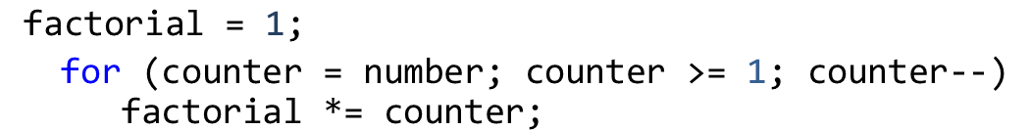
5.14 Recursion (6 of 12)
Recursively Calculating Factorials
The factorial of a nonnegative integer n, written
(pronounced “n factorial”), is the product
which is equal to 120.
The factorial of an integer, number, greater than or equal to 0 can be calculated iteratively (non recursively) using a for statement as follows:
For example,

Slide 106


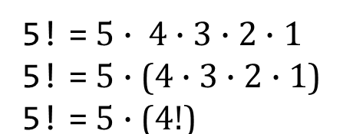

5.14 Recursion (7 of 12)
A recursive definition of the factorial function is arrived at by observing the following relationship:
For example,
as is shown by the following:
would proceed as shown in Figure 5.17
The evaluation of

Slide 107

5.14 Recursion (8 of 12)
Figure 5.17(a) shows how the succession of recursive calls proceeds until
is evaluated to be 1 (i.e., the base case), which terminates the recursion.
Figure 5.17(b) shows the values returned from each recursive call to its caller until the final value is calculated and returned.
Figure 5.18 uses recursion to calculate and print the factorials of the integers 0–10 (the choice of the type unsigned long long int will be explained momentarily).

Slide 108
5.14 Recursion (9 of 12)
If number is indeed less than or equal to 1, factorial returns 1, no further recursion is necessary, and the program terminates.
If number is greater than 1, the statement
expresses the problem as the product of number and a recursive call to factorial evaluating the factorial of number − 1.
The call factorial(number − 1) is a slightly simpler problem than the original calculation factorial(number).

Slide 109

5.14 Recursion (10 of 12)
Function factorial has been declared to receive a parameter of type long and return a result of type long.
This is shorthand notation for long int.
The C standard specifies that a variable of type long int is stored in at least 4 bytes, and thus may hold a value as large as +2147483647.
As can be seen in Figure 5.14, factorial values become large quickly.
We’ve chosen the data type long so the program can calculate factorials greater than
on computers with small (such as 2-byte) integers.

Slide 110

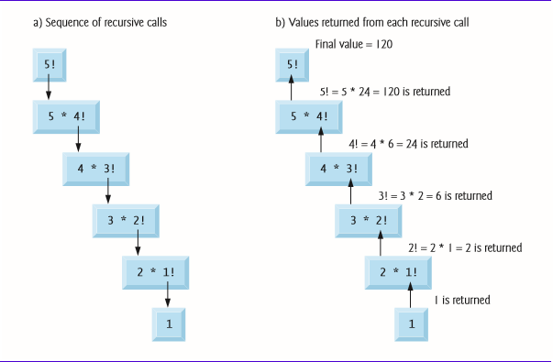
Figure 5.17 Recursive Evaluation of

Slide 111
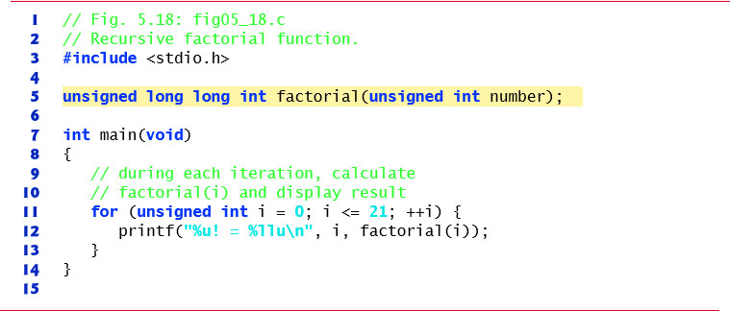
Figure 5.18 Recursive Factorial Function (1 of 3)

Slide 112
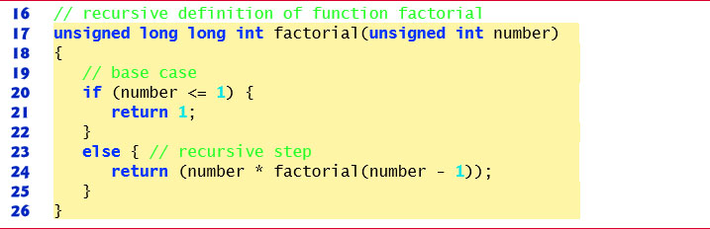
Figure 5.18 Recursive Factorial Function (2 of 3)

Slide 113
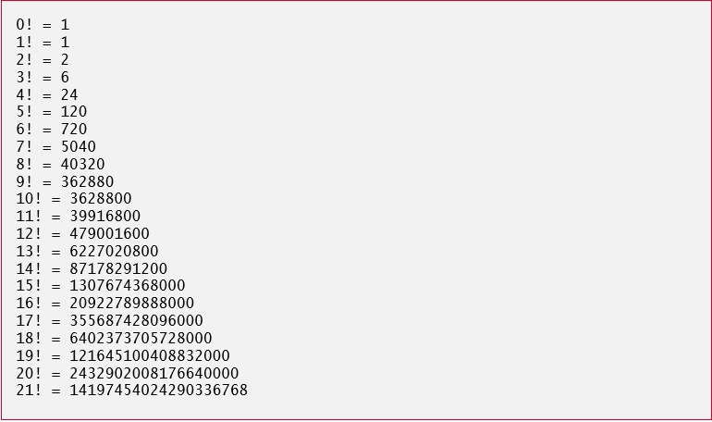
Figure 5.18 Recursive Factorial Function (3 of 3)

Slide 114


5.14 Recursion (11 of 12)
The recursive factorial function first tests whether a terminating condition is true, i.e., whether number is less than or equal to 1.
The conversion specifier
is used to print unsigned long long int values.
Unfortunately, the factorial function produces large values so quickly that even unsigned long long int does not help us print very many factorial values before the maximum value of an unsigned long long int variable is exceeded.
Even when we use unsigned long long int, we still can’t calculate factorials beyond

Slide 115
5.14 Recursion (12 of 12)
This points to a weakness in C (and most other procedural programming languages)—namely that the language is not easily extended to handle the unique requirements of various applications.
As we’ll see later in the book, C++ is an extensible language that, through “classes,” allows us to create new data types, including ones that could hold arbitrarily large integers if we wish.

Slide 116
Common Programming Error 5.9
Forgetting to return a value from a recursive function when one is needed.

Slide 117
Common Programming Error 5.10
Either omitting the base case, or writing the recursion step incorrectly so that it does not converge on the base case, will cause infinite recursion, eventually exhausting memory. This is analogous to the problem of an infinite loop in an iterative (nonrecursive) solution.

Slide 118
5.15 Example Using Recursion: Fibonacci Series (1 of 11)
The Fibonacci series
    0, 1, 1, 2, 3, 5, 8, 13, 21, …
begins with 0 and 1 and has the property that each subsequent Fibonacci number is the sum of the previous two Fibonacci numbers.
The series occurs in nature and, in particular, describes a form of spiral.
The ratio of successive Fibonacci numbers converges to a constant value of 1.618….

Slide 119
5.15 Example Using Recursion: Fibonacci Series (2 of 11)
This number, too, repeatedly occurs in nature and has been called the golden ratio or the golden mean.
Humans tend to find the golden mean aesthetically pleasing.
Architects often design windows, rooms, and buildings whose length and width are in the ratio of the golden mean.
Postcards are often designed with a golden mean length/width ratio.

Slide 120
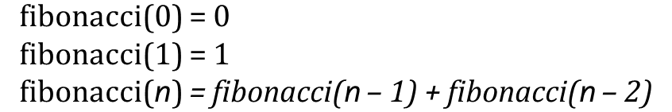
5.15 Example Using Recursion: Fibonacci Series (3 of 11)
The Fibonacci series may be defined recursively as follows:
Figure 5.19 calculates the n^{th} Fibonacci number recursively using function fibonacci.
Notice that Fibonacci numbers tend to become large quickly.
Therefore, we’ve chosen the data type unsigned int for the parameter type and the data type unsigned long long int for the return type in function fibonacci.
In Figure 5.19, each pair of output lines shows a separate run of the program.

Slide 121
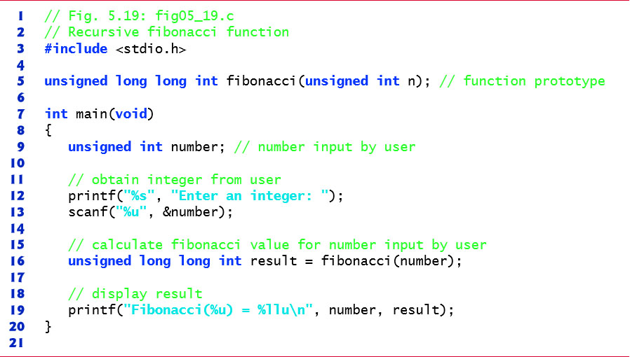
Figure 5.19 Recursive Fibonacci Function (1 of 3)

Slide 122
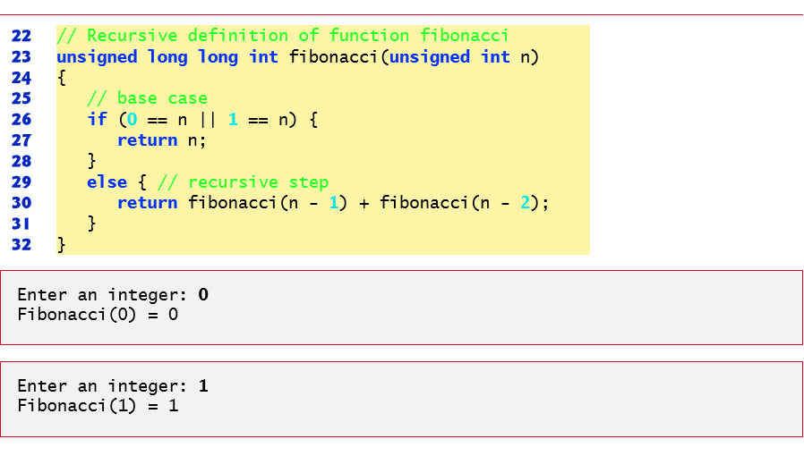
Figure 5.19 Recursive Fibonacci Function (2 of 3)

Slide 123
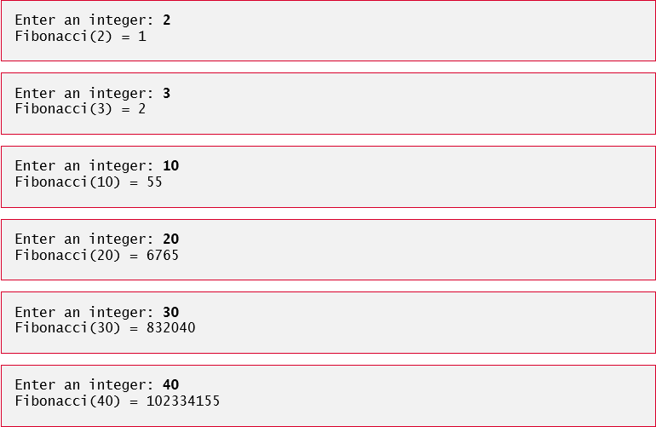
Figure 5.19 Recursive Fibonacci Function (3 of 3)

Slide 124
5.15 Example Using Recursion: Fibonacci Series (4 of 11)
The call to fibonacci from main is not a recursive call, but all subsequent calls to fibonacci are recursive
Each time fibonacci is invoked, it immediately tests for the base case—n is equal to 0 or 1.
If this is true, n is returned.
Interestingly, if n is greater than 1, the recursion step generates two recursive calls, each a slightly simpler problem than the original call to fibonacci.
Figure 5.20 shows how function fibonacci would evaluate fibonacci(3).

Slide 125
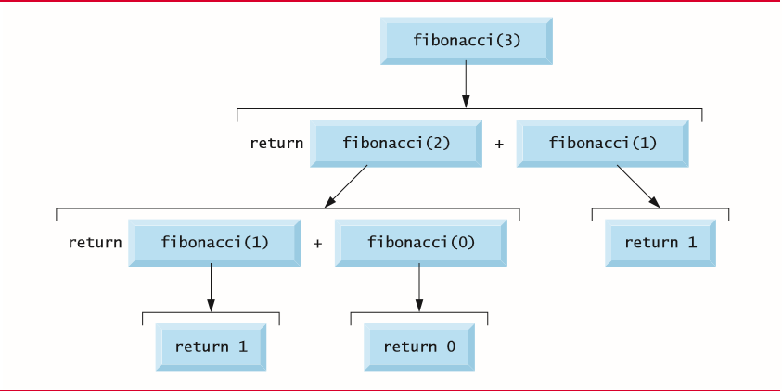
Figure 5.20 Set of Recursive Calls for Fibonacci(3)

Slide 126
5.15 Example Using Recursion: Fibonacci Series (5 of 11)
Order of Evaluation of Operands
This figure raises some interesting issues about the order in which C compilers will evaluate the operands of operators.
This is a different issue from the order in which operators are applied to their operands, namely the order dictated by the rules of operator precedence.
Figure 5.20 shows that while evaluating fibonacci(3), two recursive calls will be made, namely fibonacci(2) and fibonacci(1).
But in what order will these calls be made? You might simply assume the operands will be evaluated left to right.

Slide 127
5.15 Example Using Recursion: Fibonacci Series (6 of 11)
For optimization reasons, C does not specify the order in which the operands of most operators (including +) are to be evaluated.
Therefore, you should make no assumption about the order in which these calls will execute.
The calls could in fact execute fibonacci(2) first and then fibonacci(1), or the calls could execute in the reverse order, fibonacci(1) then fibonacci(2).
In this program and in most other programs, the final result would be the same.

Slide 128
5.15 Example Using Recursion: Fibonacci Series (7 of 11)
But in some programs the evaluation of an operand may have side effects that could affect the final result of the expression.
C specifies the order of evaluation of the operands of only four operators—namely
The first three of these are binary operators whose operands are guaranteed to be evaluated left to right.

Slide 129
5.15 Example Using Recursion: Fibonacci Series (8 of 11)
[Note: The commas used to separate the arguments in a function call are not comma operators.] The last operator is C ’ s only ternary operator.
Its leftmost operand is always evaluated first; if the leftmost operand evaluates to nonzero, the middle operand is evaluated next and the last operand is ignored; if the leftmost operand evaluates to zero, the third operand is evaluated next and the middle operand is ignored.

Slide 130

Common Programming Error 5.11
Writing programs that depend on the order of evaluation of the operands of operators other than
operator can lead to errors because compilers may not necessarily evaluate the operands in the order you expect.

Slide 131



5.15 Example Using Recursion: Fibonacci Series (9 of 11)
Exponential Complexity
A word of caution is in order about recursive programs like the one we use here to generate Fibonacci numbers.
Each level of recursion in the fibonacci function has a doubling effect on the number of calls—the number of recursive calls that will be executed to calculate the n^{th} Fibonacci number is on the order of
This rapidly gets out of hand.
Calculating only the 20th Fibonacci number would require on
The order of
or about a million calls, calculating the 30th
Fibonacci number would require on the order of
or about a billion calls, and so on.

Slide 132
5.15 Example Using Recursion: Fibonacci Series (10 of 11)
Computer scientists refer to this as exponential complexity.
Problems of this nature humble even the world’s most powerful computers!
Complexity issues in general, and exponential complexity in particular, are discussed in detail in the upper-level computer science curriculum course generally called “Algorithms.”

Slide 133
5.15 Example Using Recursion: Fibonacci Series (11 of 11)
The example we showed in this section used an intuitively appealing solution to calculate Fibonacci numbers, but there are better approaches.
Exercise 5.48 asks you to investigate recursion in more depth and propose alternate approaches to implementing the recursive Fibonacci algorithm.

Slide 134
5.16 Recursion versus. Iteration (1 of 6)
Both iteration and recursion are based on a control statement: Iteration uses a repetition statement; recursion uses a selection statement.
Both iteration and recursion involve repetition: Iteration explicitly uses a repetition statement; recursion achieves repetition through repeated function calls.
Iteration and recursion each involve a termination test: Iteration terminates when the loop-continuation condition fails; recursion when a base case is recognized.

Slide 135
5.16 Recursion versus. Iteration (2 of 6)
Iteration with counter-controlled repetition and recursion each gradually approach termination: Iteration keeps modifying a counter until the counter assumes a value that makes the loop-continuation condition fail; recursion keeps producing simpler versions of the original problem until the base case is reached.
Both iteration and recursion can occur infinitely: An infinite loop occurs with iteration if the loop-continuation test never becomes false; infinite recursion occurs if the recursion step does not reduce the problem each time in a manner that converges on the base case. Infinite iteration and recursion typically occur as a result of errors in a program’s logic.

Slide 136
5.16 Recursion versus. Iteration (3 of 6)
Recursion has many negatives.
It repeatedly invokes the mechanism, and consequently the overhead, of function calls.
This can be expensive in both processor time and memory space.

Slide 137
5.16 Recursion versus. Iteration (4 of 6)
Each recursive call causes another copy of the function (actually only the function’s variables) to be created; this can consume considerable memory.
Iteration normally occurs within a function, so the overhead of repeated function calls and extra memory assignment is omitted.
So why choose recursion?

Slide 138
5.16 Recursion versus. Iteration (5 of 6)
Figure 5.21 summarizes by chapter the 31 recursion examples and exercises in the text.

Slide 139
Figure 5.21 Recursion Examples and Exercises in the Text (1 of 2)
Chapter 5
Factorial function
Fibonacci function
Greatest common divisor
Multiply two integers
Raising an integer to an integer power
Towers of Hanoi
Recursive main
Visualizing recursion
Chapter 6
Sum the elements of an array
Print an array
Print an array backward
Print a string backward
Check whether a string is a palindrome
Minimum value in an array
Linear search
Binary search
Eight Queens
Chapter 7
Maze traversal
Chapter 8
Printing a string input at the keyboard backward

Slide 140
Figure 5.21 Recursion Examples and Exercises in the Text (2 of 2)
Chapter 12
Search a linked list
Print a linked list backward
Binary tree insert
Preorder traversal of a binary tree
Inorder traversal of a binary tree
Postorder traversal of a binary tree
Printing trees
Appendix D
Selection sort
Quick sort
Appendix E
Fibonacci function.

Slide 141
5.16 Recursion versus. Iteration (6 of 6)
Good software engineering is important.
High performance is important.
Unfortunately, these goals are often at odds with one another.
Good software engineering is key to making more manageable the task of developing the larger and more complex software systems we need.
High performance is key to realizing the systems of the future that will place ever greater computing demands on hardware.
Where do functions fit in here?

